Slide 1
尼諾思科技股份有限公司 報告人：teuton
CNN GRU

Slide 2
大綱

Slide 3
Pytorch

Slide 4
What is Pytorch?
PyTorch is an optimized tensor library for deep learning using GPUs and CPUs.
import torch
import torch.nn as nn
import torchvision.transforms as transforms
import torch.nn.functional as F

Slide 5
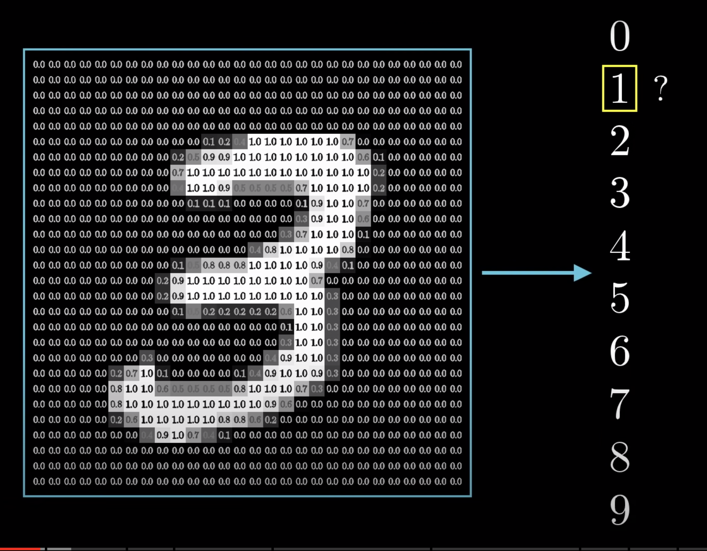
Goal of machine learning

Slide 6
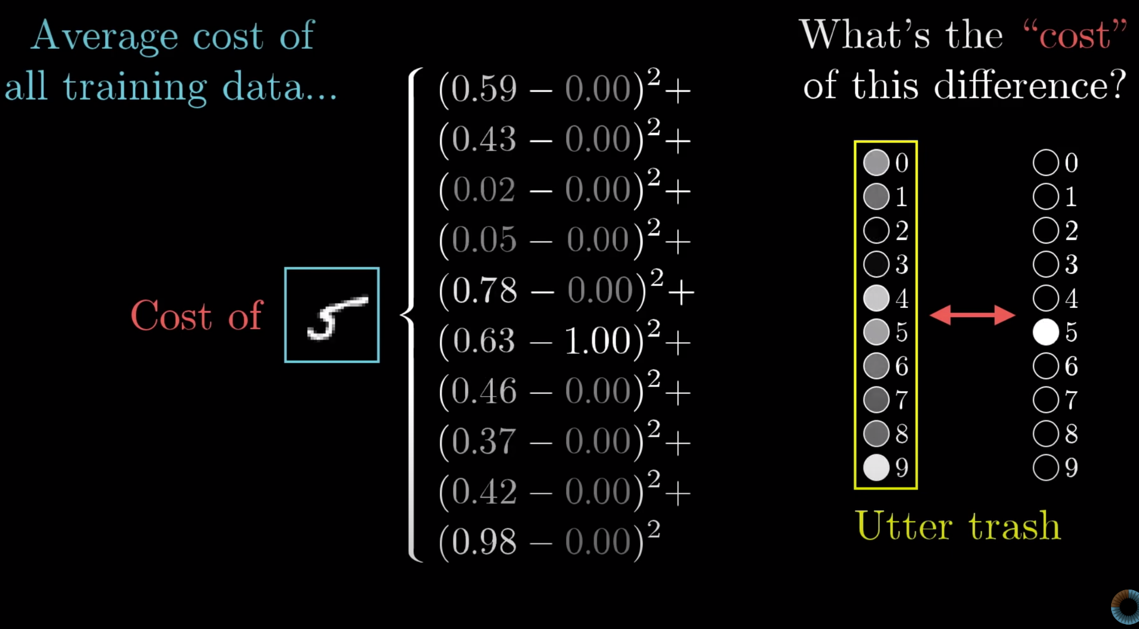
How does machine learning work?

Slide 7
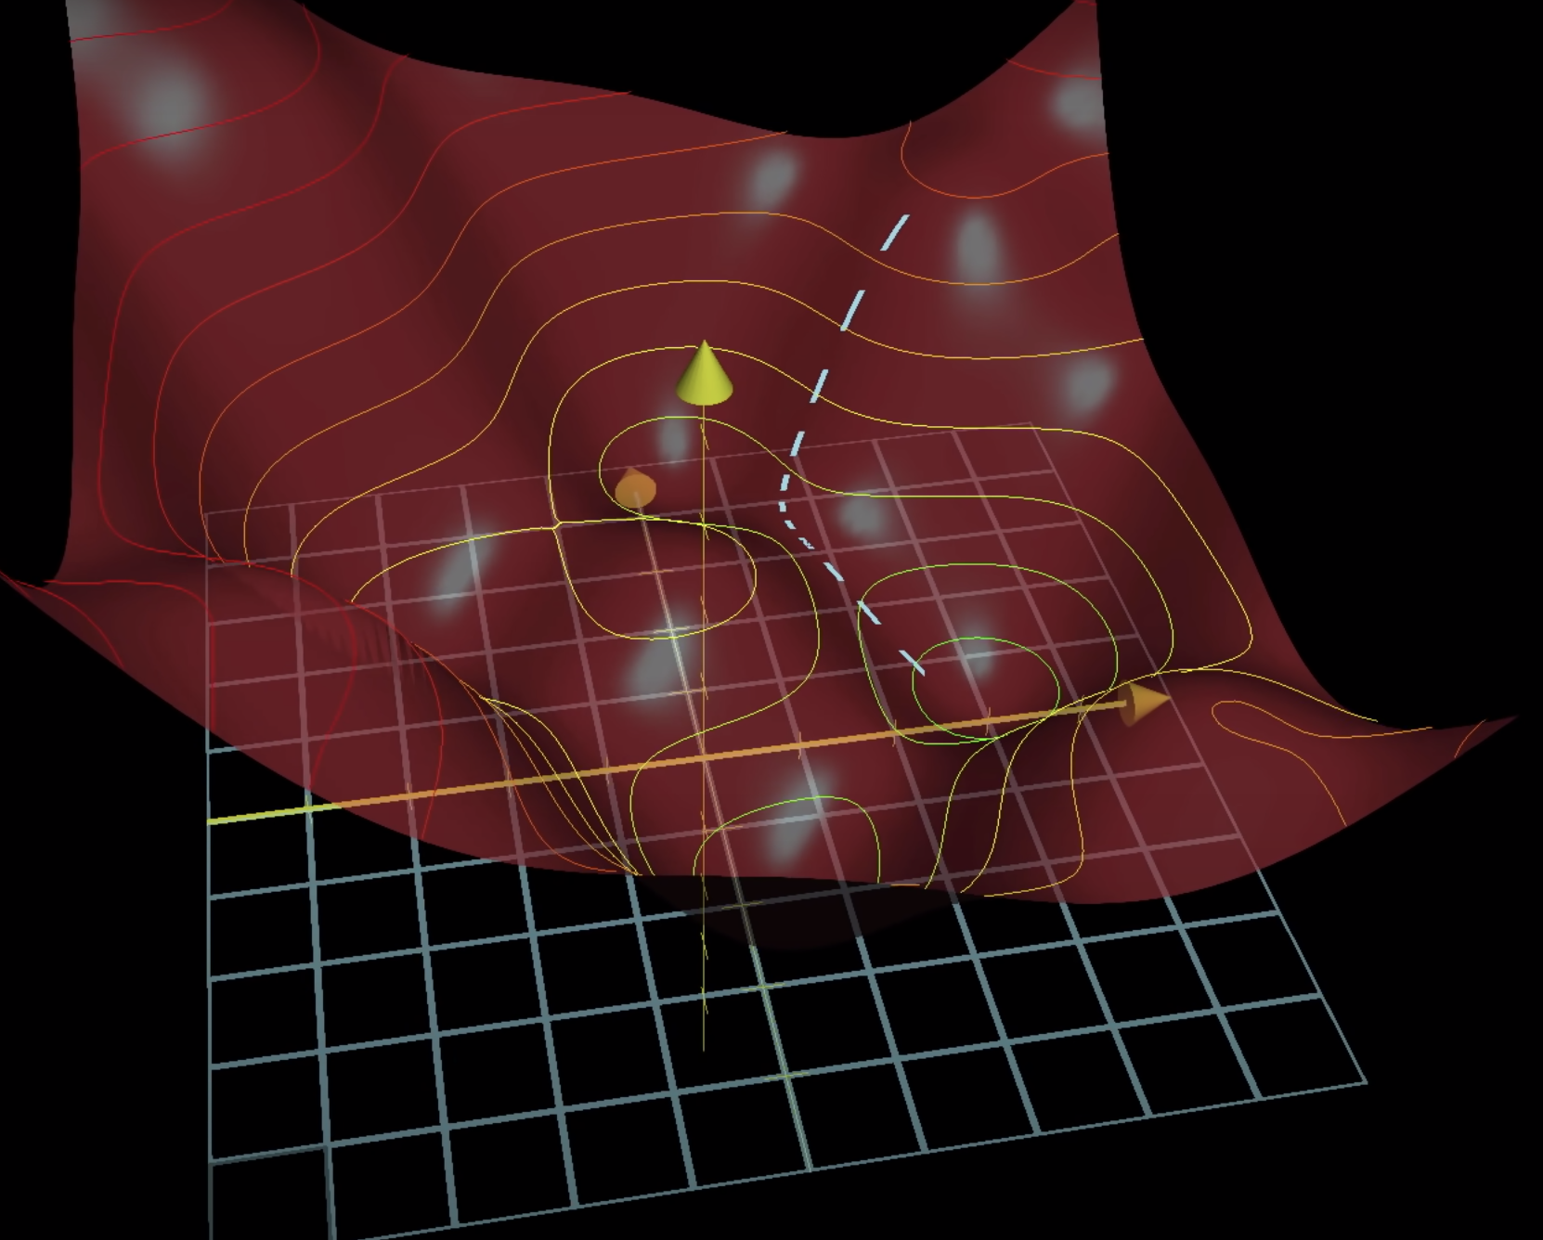
How does machine learning work?

Slide 8
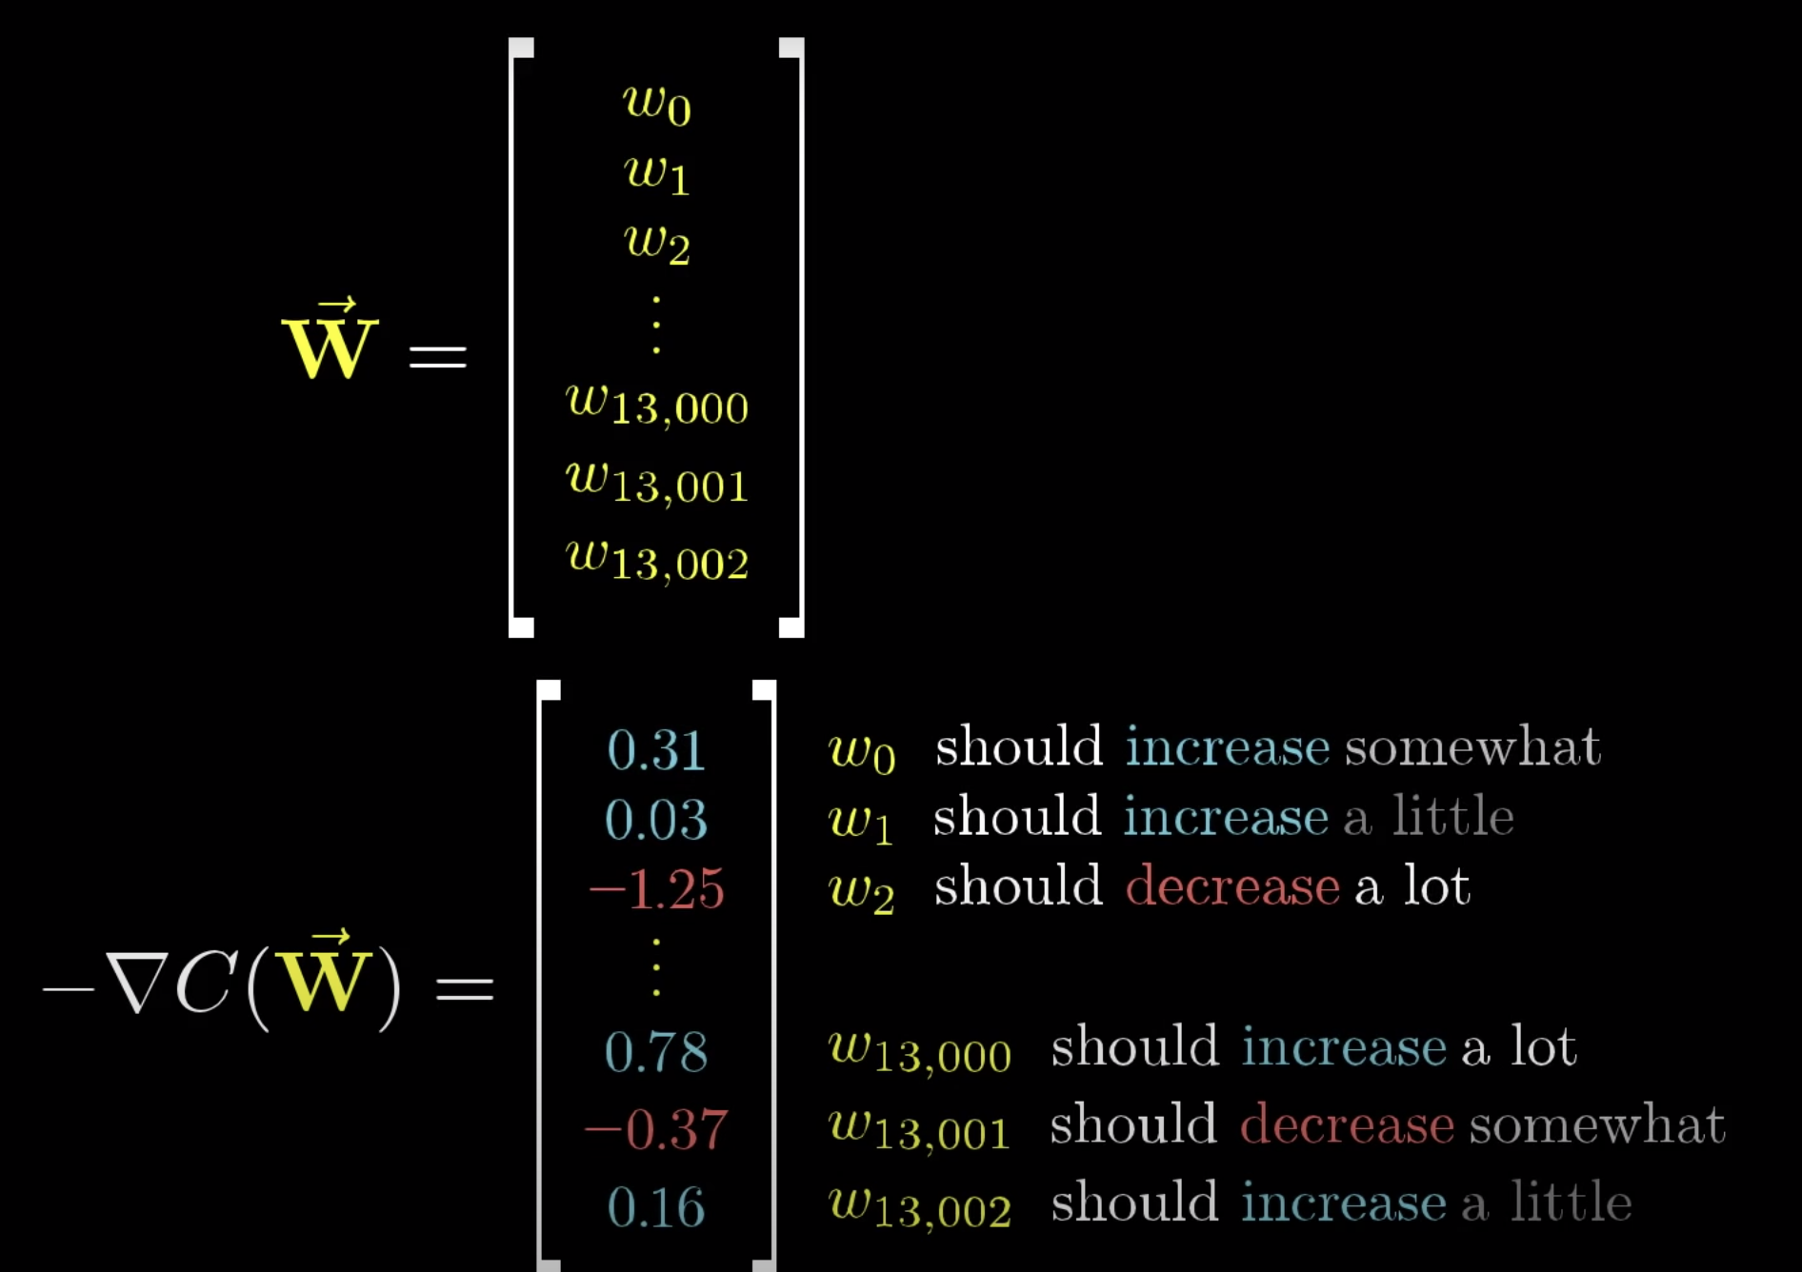
How does machine learning work?

Slide 9
Loss function and optimizer
criterion = nn.CrossEntropyLoss()
optimizer = torch.optim.Adam(model.parameters(), lr=learning_rate)
…
outputs = model(images)
loss = criterion(outputs, labels)
optimizer.zero_grad()
loss.backward()
optimizer.step()

Slide 10
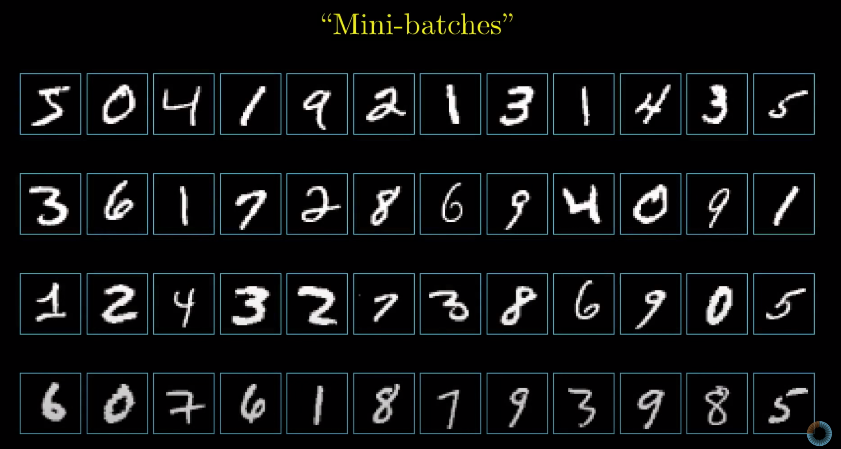
Batch

Slide 11
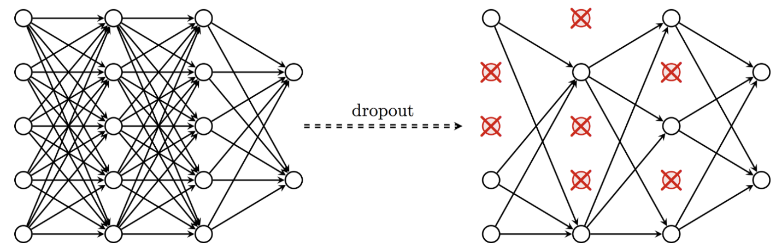
Dropout Layer
self.cdo = nn.Dropout(p = 0.5)

Slide 12
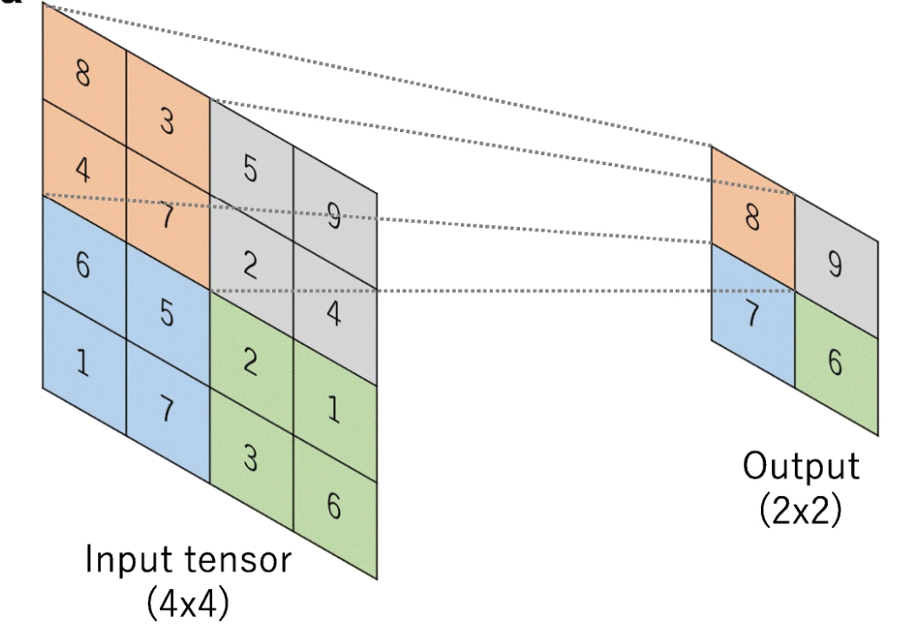
Pooling
out2 = F.max_pool1d(out2, 2)

Slide 13
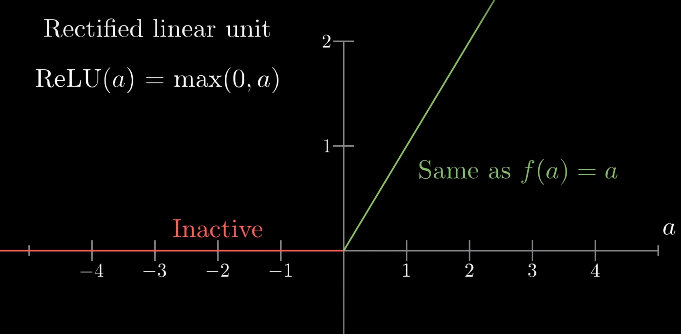
Activation function (sigmoid)
out2 = F.relu(out2)

Slide 14
Forward
out2 = torch.transpose(x, 1, 2)
out2 = self.c1(out2)

Slide 15
MLP

Slide 16
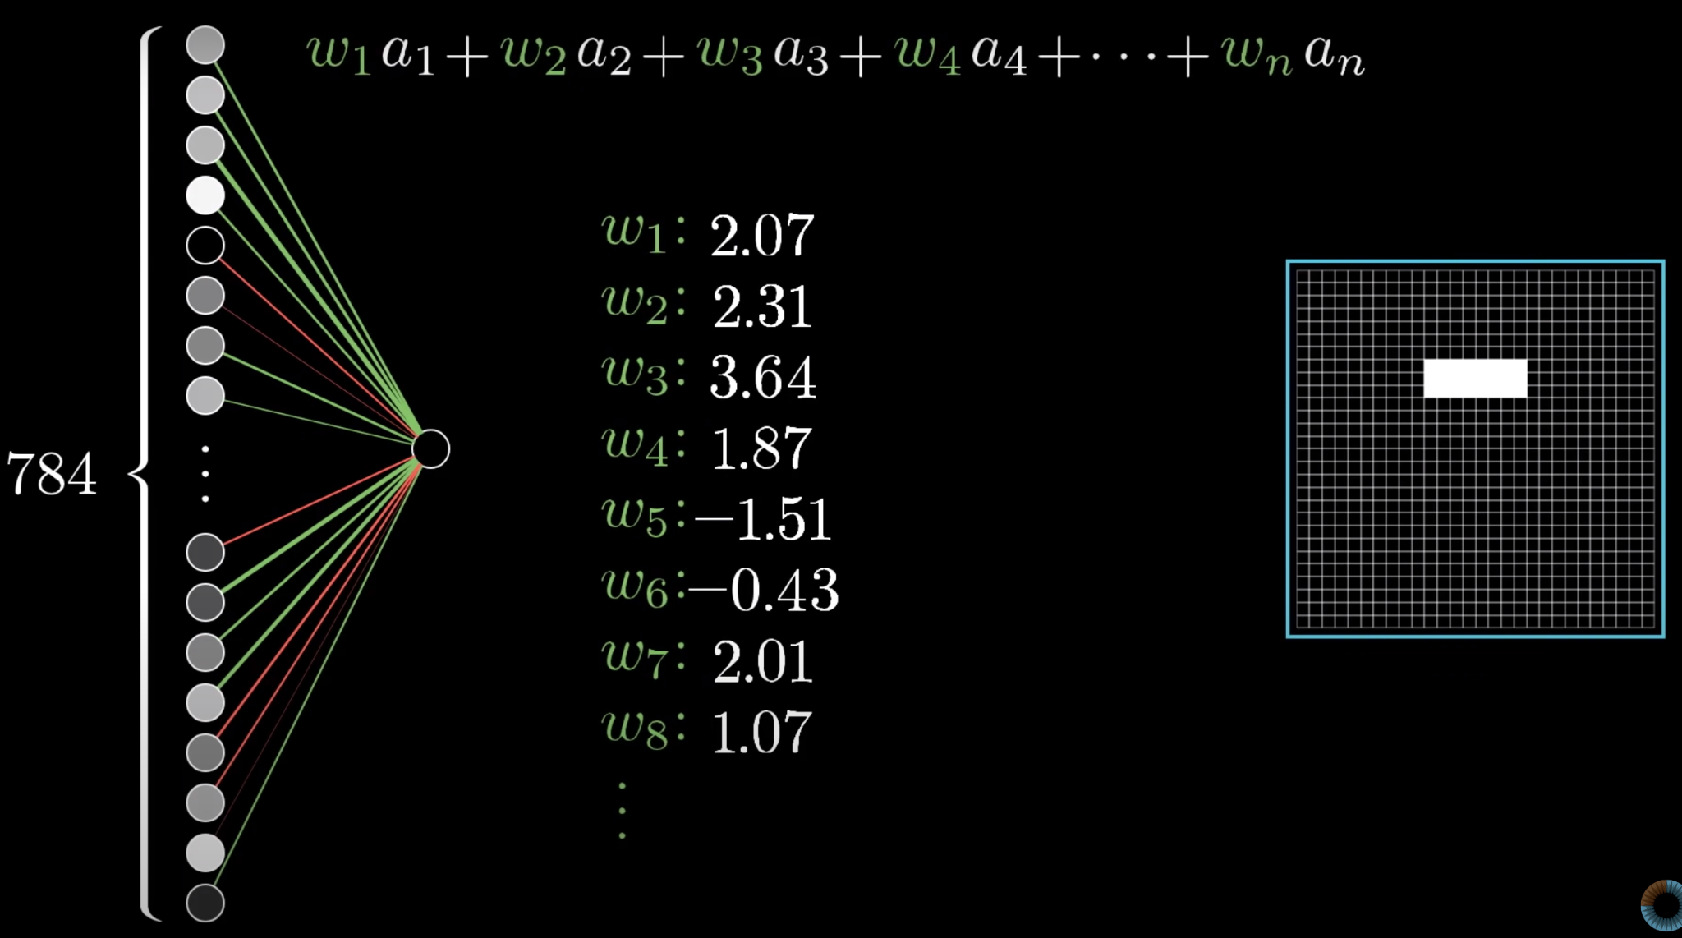
Multi-Layer Perception

Slide 17
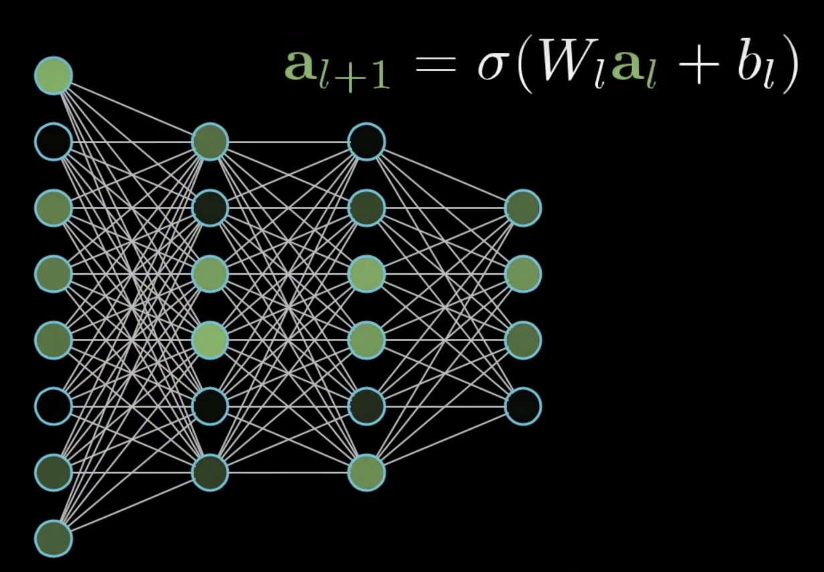
Multi-Layer Perception
self.fc = nn.Linear(hidden_size2, hidden_mlp)

Slide 18
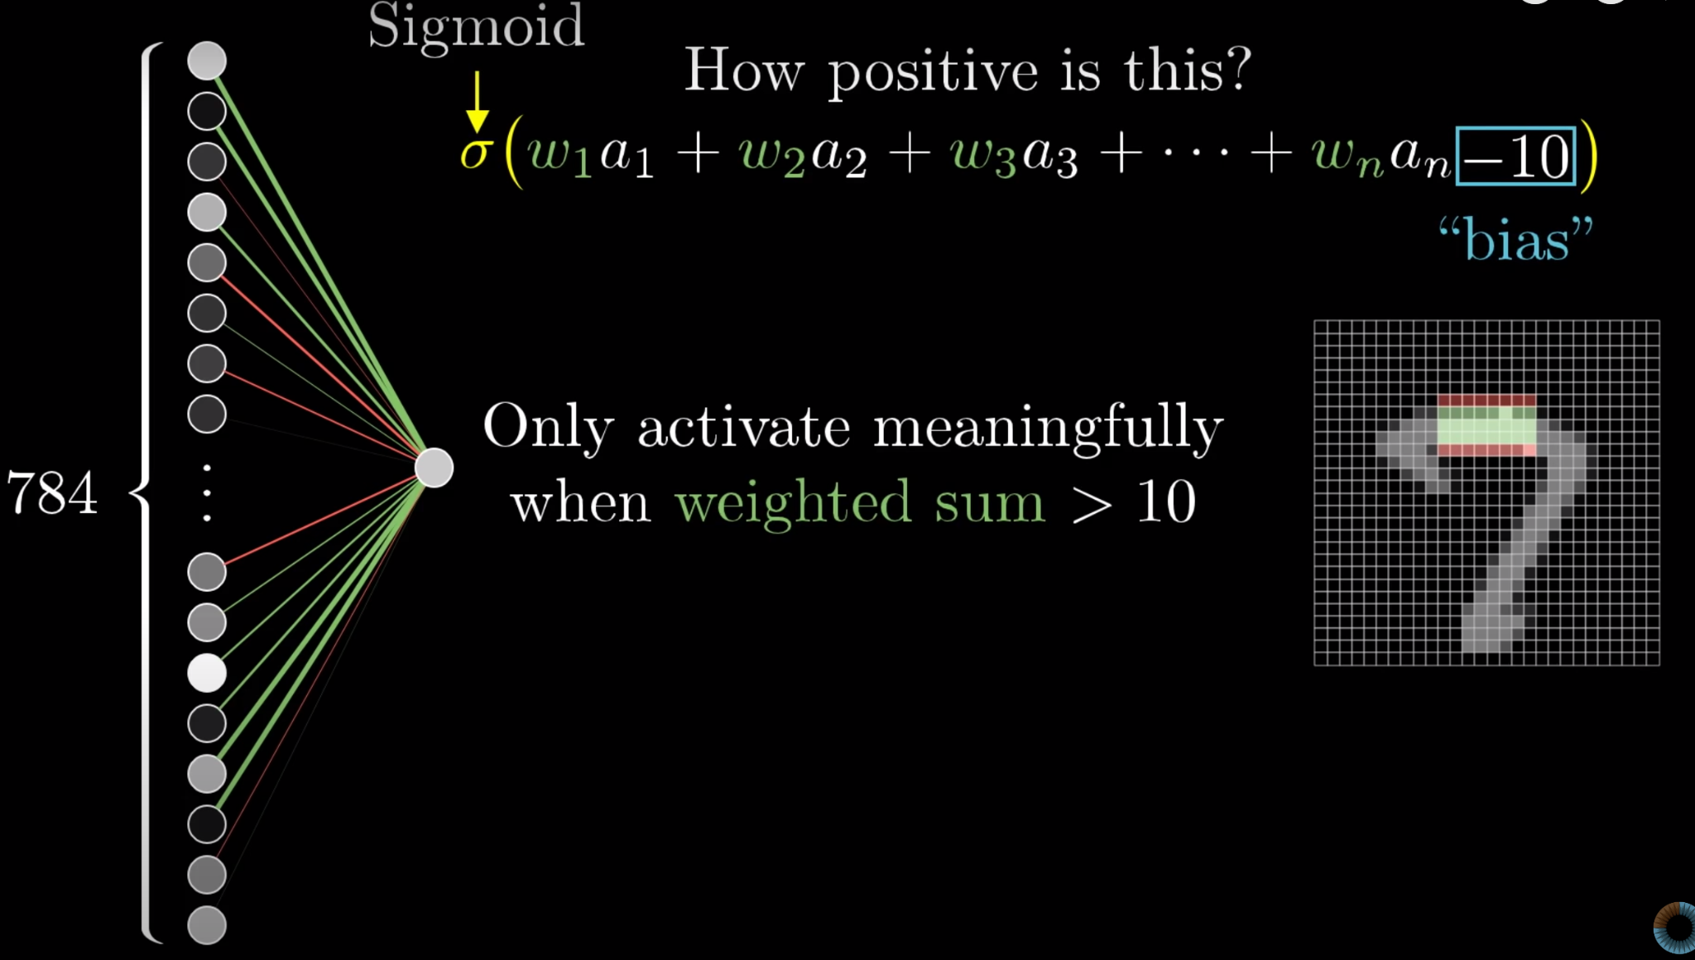
Multi-Layer Perception

Slide 19
CNN

Slide 20
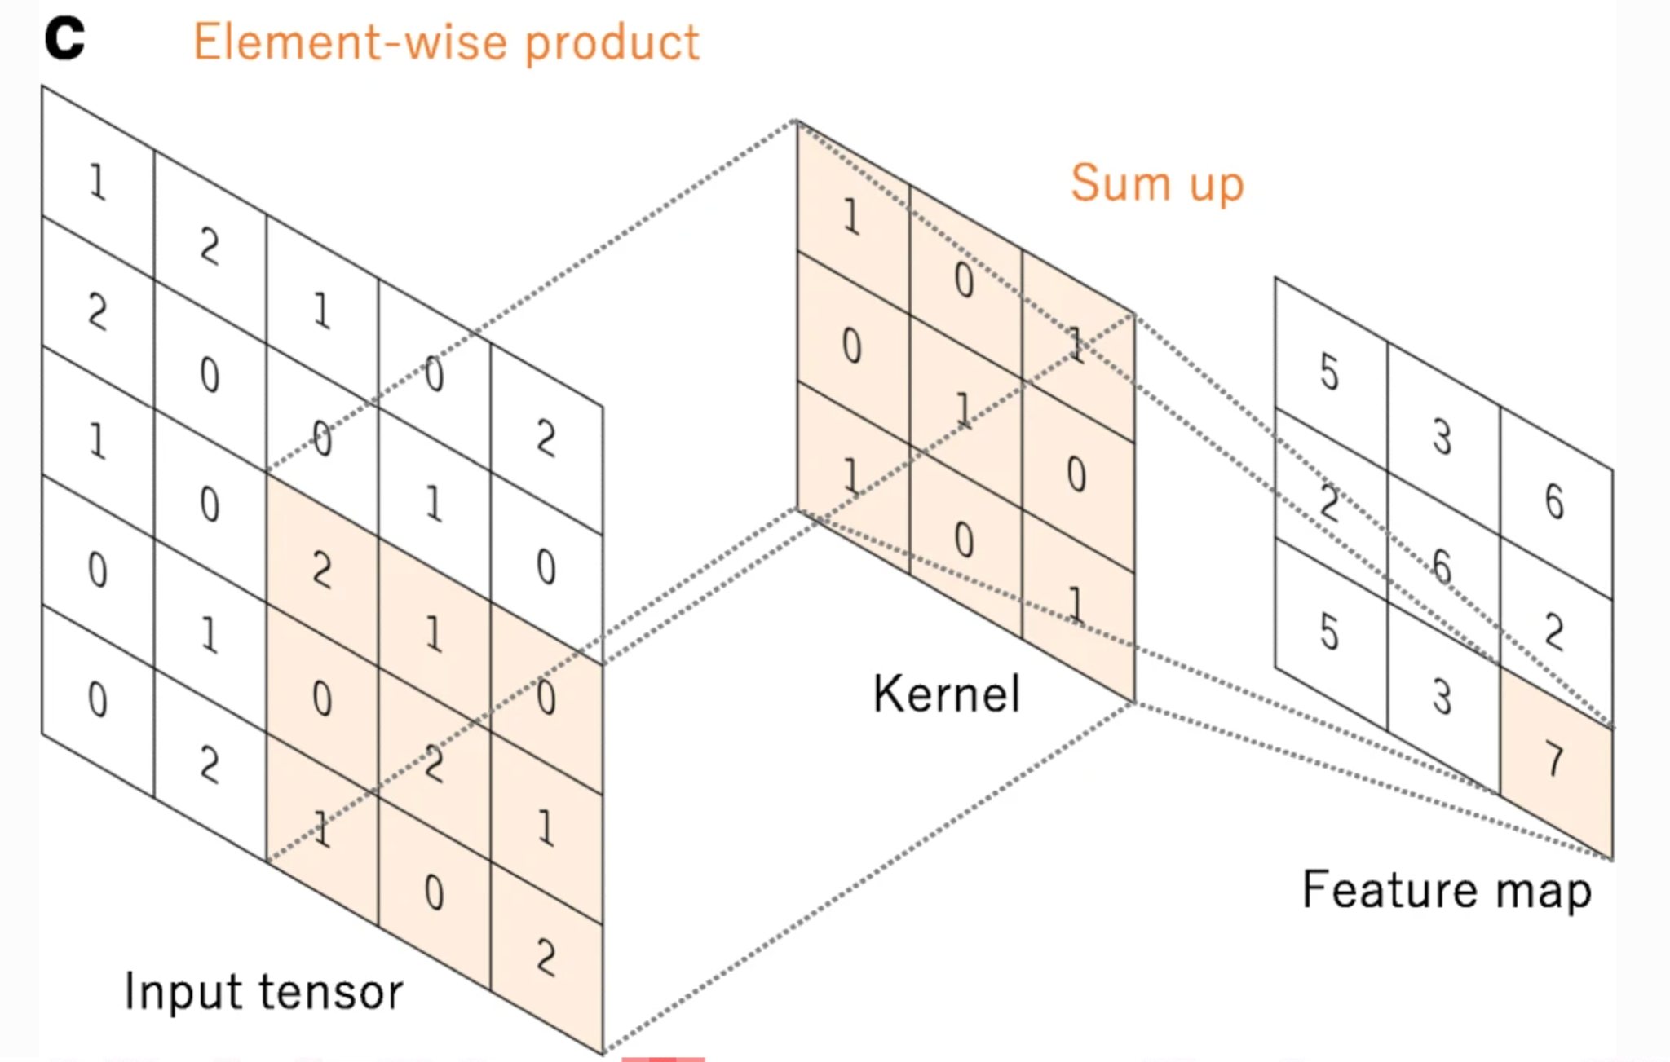
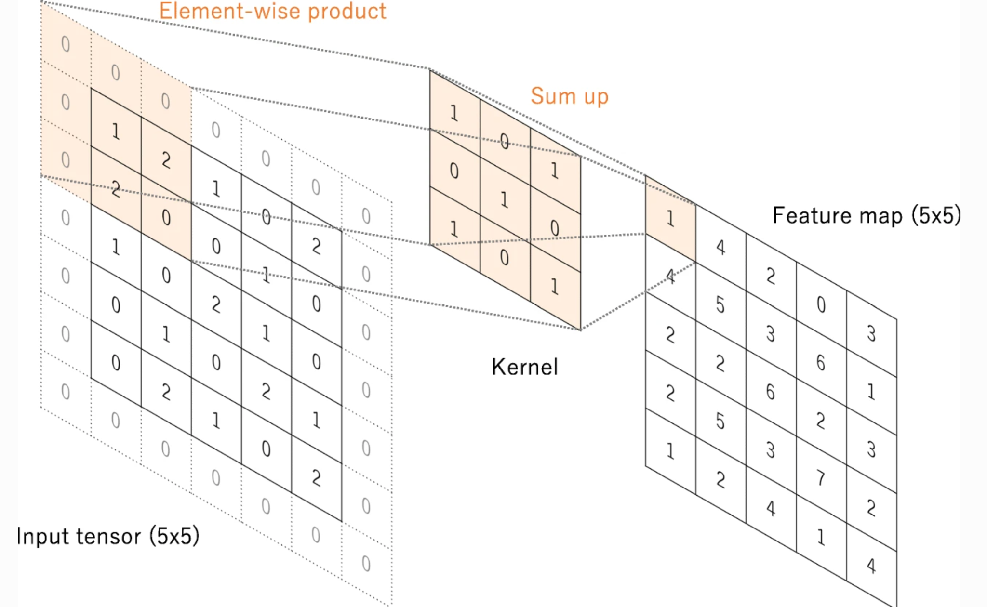
Convolution Neuron Network

Slide 21
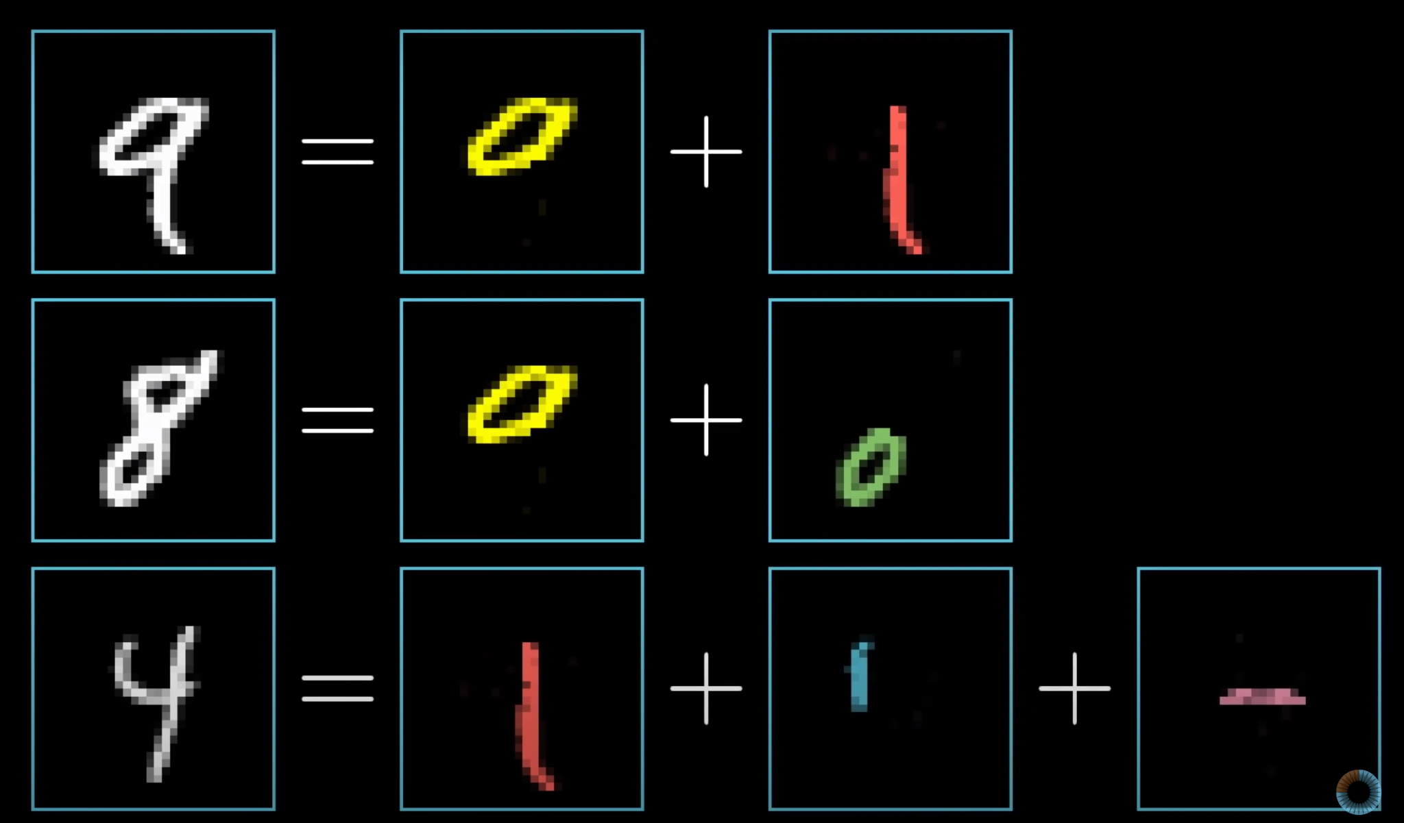
How does CNN work?

Slide 22
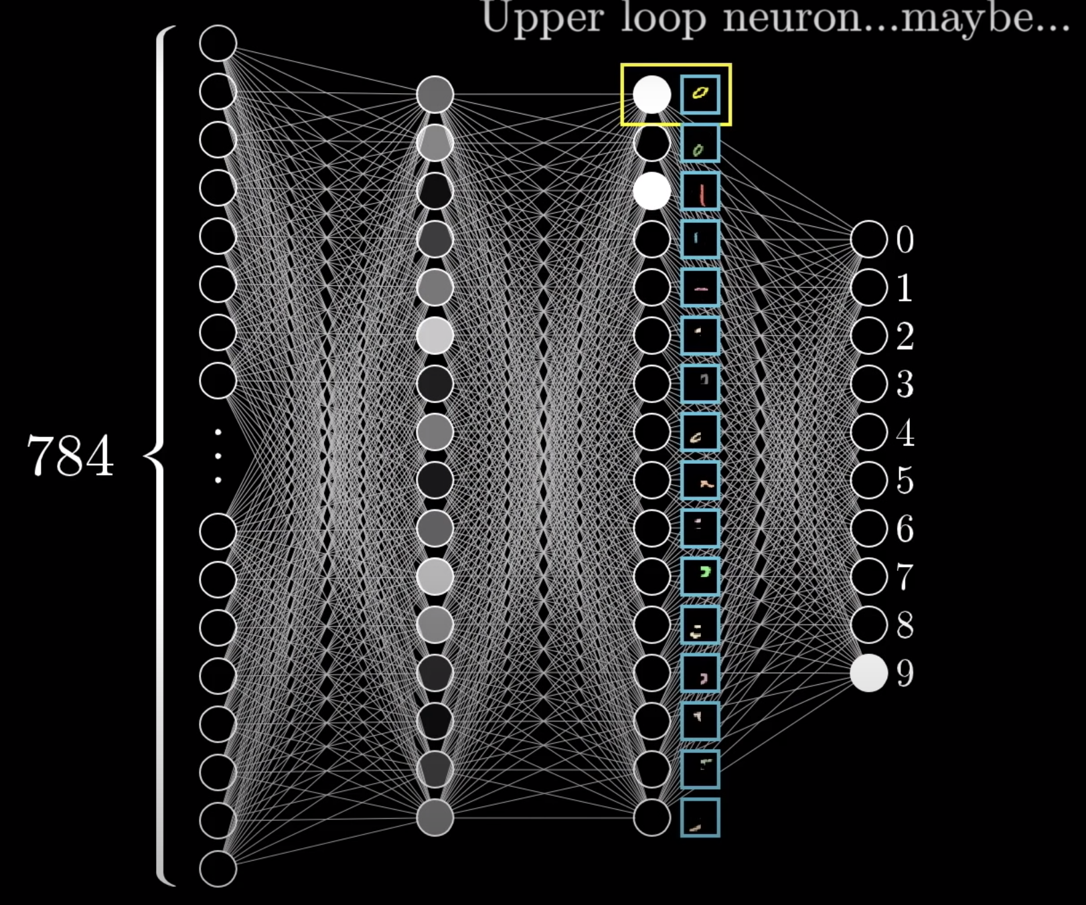
How does CNN work?

Slide 23
Code
self.c1 = nn.Conv1d(in_channels = input_size, out_channels = hidden_c1, kernel_size = 3, padding = 0)

Slide 24
GRU

Slide 25
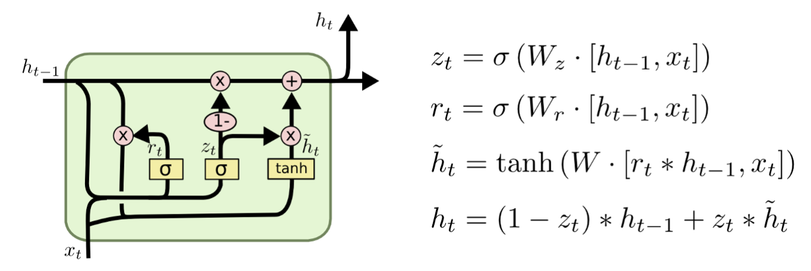
Gated Recurrent Unit

Slide 26
Code
self.gru = nn.GRU(input_size, hidden_gru, num_layers, batch_first=True)
…
h0 = torch.zeros(self.num_layers, x.size(0), self.hidden_gru).to(device)
out1, _ = self.gru(x, h0)
out1 = out1[:, -1, :]

Slide 27
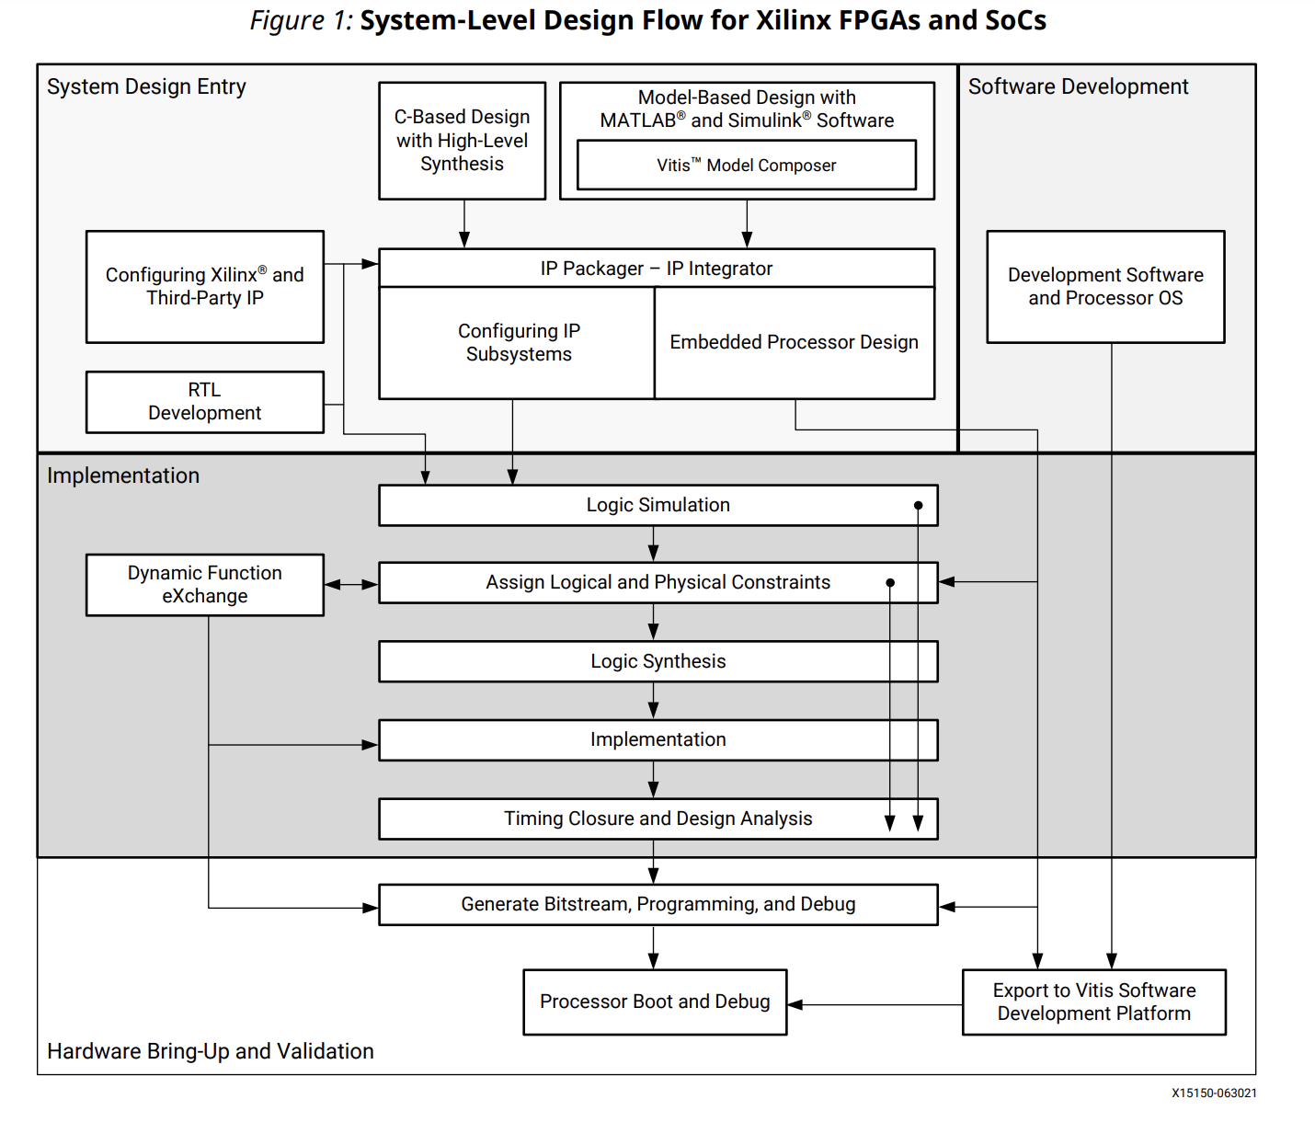

Slide 28

NínoX CIS (Corporate Identity System)
NínoX
Font
Arial Black
Color
橘色(HEX #FF6600 ; RGB 255, 102, 0)
藍綠色(HEX #009999 ; RGB 0, 153, 153)
紫色Violet (HEX #8B00FF ; RGB 139, 0, 255)
黑色 Black(HEX #000000 ; RGB 0,0,0)
<font face="Arial Black" color="#FF6600"> NínoX </font>

Slide 30
Thank You. 簡報完畢

